Slide 1


Alex J Torres
May 13th, 2022

Slide 2

Outline
Executive Summary
Introduction
Methodology
Results
Conclusion
Appendix

Slide 3
Executive Summary
Summary of methodologies
Data Collection through API and Web Scraping
Data Wrangling
Exploratory Data Analysis (EDA) with SQL and Data Visualization
Interactive Visual Analytics with Folium
Machine Learning Prediction
Summary of all results
Exploratory Data Analysis result
Interactive analytics in screenshots
Predictive Analytics result

Slide 4
Introduction
Project background and context
Space X advertises Falcon 9 rocket launches on its website with a cost of 62 million dollars while other providers have a cost upward of 165 million dollars each. Much of the savings is because Space X can reuse the first stage of launch. Therefore, if we can determine if the first stage will land, we can determine the cost of a launch. This information can be used if an alternate company wants to bid against Space X for a rocket launch. The goal of the project is to create a machine learning pipeline to predict if the first stage will land successfully.
Questions we want to find answers for:
What factors determine if the rocket will land successfully?
What interaction, among various features, will determine the success rate of a landing?
What conditions needs to be in place to ensure a successful landing?

Slide 5

Section 1

Slide 6
Methodology
Executive Summary
Data collection methodology:
Data was collected using SpaceX API and web scraping from Wikipedia.
Perform data wrangling
One-hot encoding was applied to categorical features
Perform exploratory data analysis (EDA) using Data visualization and SQL
Perform interactive visual analytics using Folium and Plotly Dash
Perform predictive analysis using classification models
How to build, evaluate, and determine the best classification models

Slide 7
Data Collection
The data was collected using various methods
Data collection was done using get request to the SpaceX API.
Next, we decoded the response content as a Json using .json() function call and turned it into a Pandas dataframe using .json_normalize().
Then, we cleaned the data, checked for missing values, and filled in missing values when necessary.
In addition, we performed web scraping from Wikipedia for Falcon 9 launch records with BeautifulSoup.
The objective was to extract the launch records as HTML table, parse the table, and convert it to a pandas dataframe for further analysis.

Slide 8
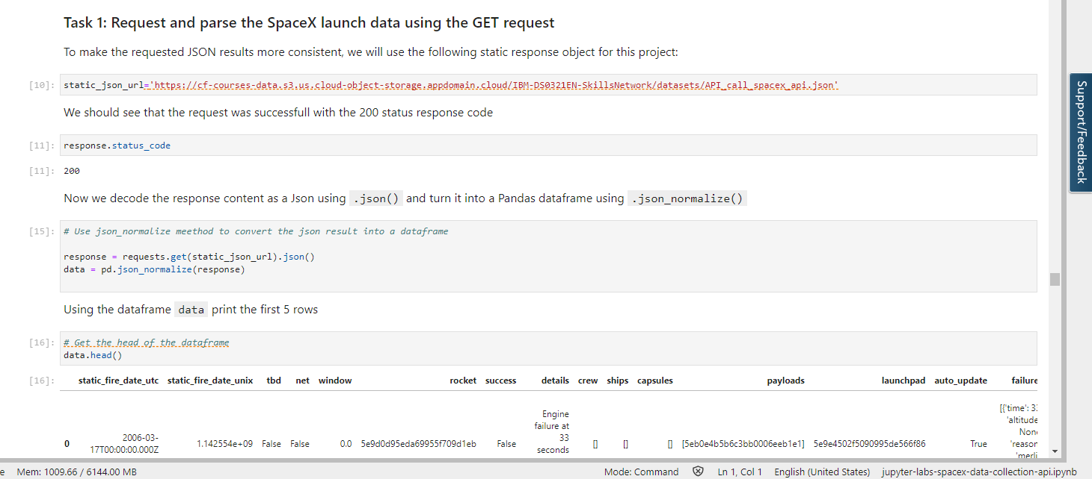
Data Collection – SpaceX API
We used the get request to the SpaceX API to collect data, clean the requested data, and did some data wrangling and formatting.
Link: https://github.com/AlexTorres1994/IBM-Course-10-SpaceX-Falcon-Capstone/blob/main/jupyter-labs-spacex-data-collection-api%20(1).ipynb

Slide 9
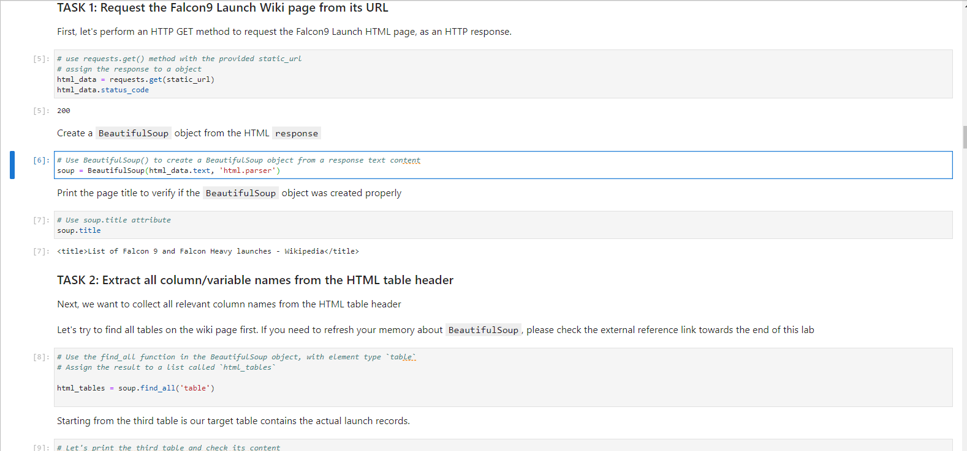
Data Collection - Scraping
We applied web scraping to web scrap Falcon 9 launch records with BeautifulSoup.
We analyzed the table and converted it into a pandas dataframe.
Link: https://github.com/AlexTorres1994/IBM-Course-10-SpaceX-Falcon-Capstone/blob/main/jupyter-labs-webscraping.ipynb

Slide 10

Data Wrangling
We performed exploratory data analysis and determined the training labels.
The number of launches at each site and the occurrence of each orbits were calculated.
Landing outcome label from outcome column were created and the results exported to a csv.
Link: https://github.com/AlexTorres1994/IBM-Course-10-SpaceX-Falcon-Capstone/blob/main/3.%20wrangling.ipynb

Slide 11


EDA with Data Visualization
The data was explored by visualizing the relationship between flight number and launch Site, payload and launch site, success rate of each orbit type, flight number, orbit type, and the launch success yearly trend.
Link: https://github.com/AlexTorres1994/IBM-Course-10-SpaceX-Falcon-Capstone/blob/main/jupyter-labs-eda-dataviz.ipynb

Slide 12
EDA with SQL
We loaded the SpaceX dataset into a PostgreSQL database without leaving the Jupyter notebook.
EDA with SQL was applied to get insight from the data and wrote queries to find out:
The names of unique launch sites in the space mission.
The total payload mass carried by boosters launched by NASA (CRS)
The average payload mass carried by booster version F9 v1.1
The total number of successful and failure mission outcomes
The failed landing outcomes of the drone ship, their booster version, and launch site names.
Link: https://github.com/AlexTorres1994/IBM-Course-10-SpaceX-Falcon-Capstone/blob/main/EDA_SQL.ipynb

Slide 13
Build an Interactive Map with Folium
We marked all launch sites and added map objects such as markers, circles, and lines to mark the success or failure of launches for each site on the folium map.
The launch outcomes (failure or success) were assigned to a class 0 and 1 (i.e. 0 for failure and 1 for success).
Using the color-labeled marker clusters, we identified which launch sites have relatively high success rates and calculated the distances between a launch site to it’s proximities to various locations on a map.
Link: https://github.com/AlexTorres1994/IBM-Course-10-SpaceX-Falcon-Capstone/blob/main/lab_jupyter_launch_site_location.ipynb

Slide 14
Build a Dashboard with Plotly Dash
We built an interactive dashboard with Plotly dash and created pie charts showing the total launches by certain sites.
Afterwards, we plotted the findings in a scatter graph showing the relationship with Outcome and Payload Mass (Kg) for the different booster versions.
Link: https://github.com/AlexTorres1994/IBM-Course-10-SpaceX-Falcon-Capstone/blob/main/app.py

Slide 15
Predictive Analysis (Classification)
We loaded the data using Numpy and Pandas, transformed the data, and split our data into training andtesting.
We built different machine learning models and tuned different hyperparameters using GridSearchCV.
Accuracy was utilized as the metric for our model and improved the model using feature engineering and algorithm tuning.
Finally, we found the best performing classification model for the project.
Link: https://github.com/AlexTorres1994/IBM-Course-10-SpaceX-Falcon-Capstone/blob/main/SpaceX_Machine%20Learning%20Prediction_Part_5.ipynb

Slide 16
Results
Exploratory data analysis results
Interactive analytics demo in screenshots
Predictive analysis results

Slide 17

Section 2

Slide 18

Flight Number vs. Launch Site
From the plot below, we can determine that the larger the flight amount at a launch site, the greater the success rate at a launch site.

Slide 19

Payload vs. Launch Site
From the plot below, we can determine that the greater the payload mass at the launch site, the higher the success rate for the rocket.

Slide 20

Success Rate vs. Orbit Type
From the bar graph, we can see that ES-L1, GEO, HEO, SSO, VLEO had the most success rate of all the orbit types.

Slide 21

Flight Number vs. Orbit Type
The plot below exhibits the Flight Number vs. Orbit type. We can observe that in the LEO orbit, success is related to the number of flights. However, in the GTO orbit, there is no relationship between flight number and the orbit.

Slide 22

Payload vs. Orbit Type
We can observe in the plot below that with heavy payloads, the success of landings are higher for PO, LEO, and ISS orbit types.

Slide 23
Launch Success Yearly Trend
From the line graph, we can observe that the success rate of launch continuously increased starting in 2013, all the way until the end of 2020.

Slide 24

All Launch Site Names
Utilizing the SELECT function with the key word DISTINCT allowed us to only show unique sites from the SpaceX data.

Slide 25

Launch Site Names Begin with 'CCA'
In the above query, we utilized the SELECT function with WHERE and LIMIT clauses to display the first 5 records where launch sites begin with ‘CCA’

Slide 26

Total Payload Mass
In the query above, utilizing the SELECT SUM function with the WHERE clause and LIKE condition, we can calculate the total payload carried by boosters from NASA as 45,596.

Slide 27

Average Payload Mass by F9 v1.1
In this query, using the SELECT AVG function with the WHERE clause, we can calculate the average payload mass carried by booster version F9 v1.1 as 2,928.4

Slide 28

First Successful Ground Landing Date
In this query, using the SELECT MIN function, with the WHERE clause and LIKE condition, we determined that the date of the first successful landing on the ground pad was on December 22, 2015.

Slide 29

Successful Drone Ship Landing with Payload between 4000 and 6000
In this query, using the SELECT function, with WHERE clause, specifying Success for drone ship with AND condition to filter for specific boosters and payloads, we can determine the successful drone ship landings with a payload mass greater than 4,000 but less than 6,000.

Slide 30

Total Number of Successful and Failure Mission Outcomes
In this query, we used the SELECT COUNT function, with the WHERE clause and LIKE condition with the wildcard % to filter out the MissionOutcome that were successful or not.

Slide 31

Boosters Carried Maximum Payload
In this query, we used the SELECT function, with the WHERE clause using the subquery MAX() function to determine the booster that carried the maximum payload.

Slide 32

2015 Launch Records
In this query, using a combination of the SELECT function, WHERE clause, and the LIKE, AND, and BETWEEN conditions, we were able to filter for only the failed landing outcomes in the drone ships, their booster version, and their launch site in the year 2015.

Slide 33

Rank Landing Outcomes Between 2010-06-04 and 2017-03-20
In this query, using the SELECT and COUNT function, with the WHERE DATE BETWEEN clause, we can filter the landing outcomes between June 6, 2010 and March 20, 2017.
Using the GROUP BY and ORDER BY clauses, we can group and order the landings in descending order of landing outcomes.

Slide 34

Section 3

Slide 35
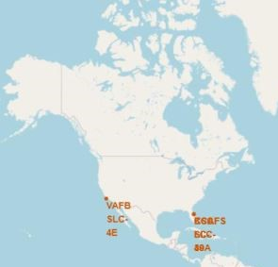
All launch sites global map markers
In the photo above, we can see the SpaceX launch sites are in both coasts of the United States of America, being situated in Florida and California.

Slide 36

Markers showing launch sites with color labels

Slide 37

Launch Site distance to landmarks

Slide 38

Section 4

Slide 39

Pie chart showing the success percentage achieved by each launch site

Slide 40

Pie chart showing the KSC LC-39A Launch site which had the highest launch success ratio

Slide 41

Scatter plot of Payload vs Launch Outcome for all sites, with different payload selected in the range slider

Slide 42

Section 5

Slide 43

Classification Accuracy
The decision tree classifier is the classifying model with the highest accuracy in classification compared to all the other models.

Slide 44

Confusion Matrix
The confusion matrix for the Decision Tree classifier shows that this classifier can help distinguish between different classes.
However, one major problem with this classifier was the false positives (unsuccessful landings) that were marked and included in the Decision Tree classifier.

Slide 45
Conclusions
After all the Data collecting, webscraping, wrangling, EDA SQL and visualization, we can conclude that:
The larger the flight amount at a launch site, the greater the success rate was at the launch site.
Launch success rate started to increase in 2013 until 2020, which was the end of the graph.
Orbits ES-L1, GEO, HEO, SSO, and VLEO had the most success rates compared to all the other orbits.
KSC LC-39A had the most successful launches of all of the sites.
The Decision tree classifier is the best machine learning algorithm for the project.

Slide 46


